Slide 1


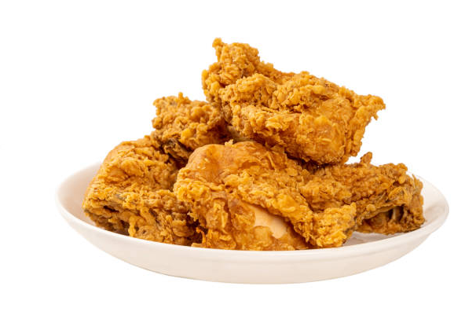



Back to Guest.
Food Outlet History Register
Fried Chicken
Sashimi Salmon
Sashimi Salmon
Sashimi Salmon
Sashimi Salmon
Sashimi Salmon
Sashimi Salmon
Sashimi Salmon
Sashimi Salmon
Name
Price
Description
Availability
Image
Upload
Save
Yudhoprameswara allright Reseverd

